Slide 1
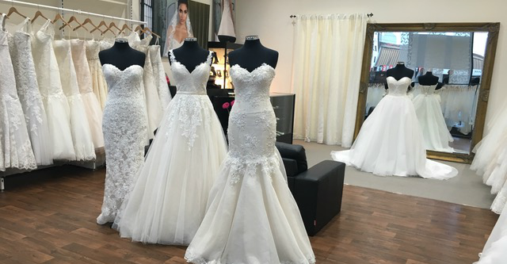
PRINCESS BRIDES [PURE INTEGER PROGRAMMING]
_______________________________
Justice Inkoom

Slide 2
SCENARIO
Liz Bailey is the owner of Princess Brides, a wedding dress retailer. She uses radio to market and two types of ads are available – those during prime time and those at other times.
Each prime time ad costs $390 and reaches 8,200 people on average. Off-peak ads cost $240 and reach 5,100 people on average. Bailey has a budget of $1800 per week for advertising.
She wants at least 2 prime time ads and no more than 6 off-peak ads.
Find the best mix of ads to purchase so the most people are reached.

Slide 3
LINEAR PROGRAMMING MODEL
 | prime | off-peak
variables: | 4 | 1
 | 8200 | 5100
constraints: |  |  | LHS | SIGN | RHS
budget | 390 | 240 | 1800 | <= | 1800
prime | 1 |  | 4 | >= | 2
off-peak |  | 1 | 1 | <= | 6
most people reached: 37900

Slide 4
SUMMARY
Liz should use 4 prime time and 1 off-peak to reach a maximum of 37900 people on average.
NOTE:
This is a pure integer programming problem so the variables should always be integers. The solver Ad-In in Excel has the option for that.

Slide 5

THANK YOU

